Slide 1

Hotel Booking Analysis Using Python

Slide 2
Business Problem
In recent years, both City Hotel and Resort Hotel have experienced high cancellation rates, resulting in reduced revenue and underutilized room capacity. The primary objective of this project is to analyze hotel booking cancellations and the factors associated with them. By doing so, we aim to provide insights and recommendations to reduce cancellation rates and improve revenue generation.
The analysis of hotel booking cancellations as well as other factors that have no bearing on their business and yearly revenue generation are the main topics of this report.

Slide 3
Assumptions
• Unusual events occurring between 2015 and 2017 do not significantly affect the data.
• The dataset is current and relevant, ensuring efficient analysis.
• Anticipated negative consequences of implementing suggested techniques are minimal.
• The hotels are not currently utilizing the proposed solutions.
• Booking cancellations have a substantial impact on revenue generation.

Slide 4
Research Question
What are the key factors that influence hotel reservation cancellations?
What strategies can be implemented to minimize hotel reservation cancellations?
How can hotels utilize data insights to make informed pricing and promotional decisions?
Hypothesis
• Higher prices are positively correlated with increased cancellation rates.
• Longer waiting lists are associated with higher frequencies of cancellations.
• Offline travel agents contribute more to reservations compared to online channels.

Slide 5
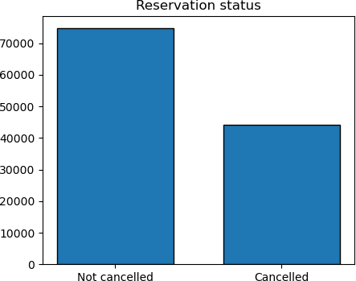
Analysis and Findings
The accompanying bar graph shows the percentage of reservations that are canceled and those that are not. It is obvious that there are still a significant number of reservations that have not been canceled. There are still 37% of clients who canceled their reservation, which has a significant impact on the hotels' earnings.

Slide 6
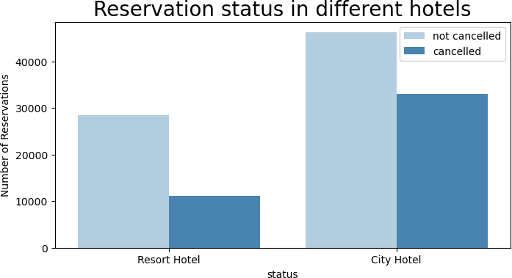
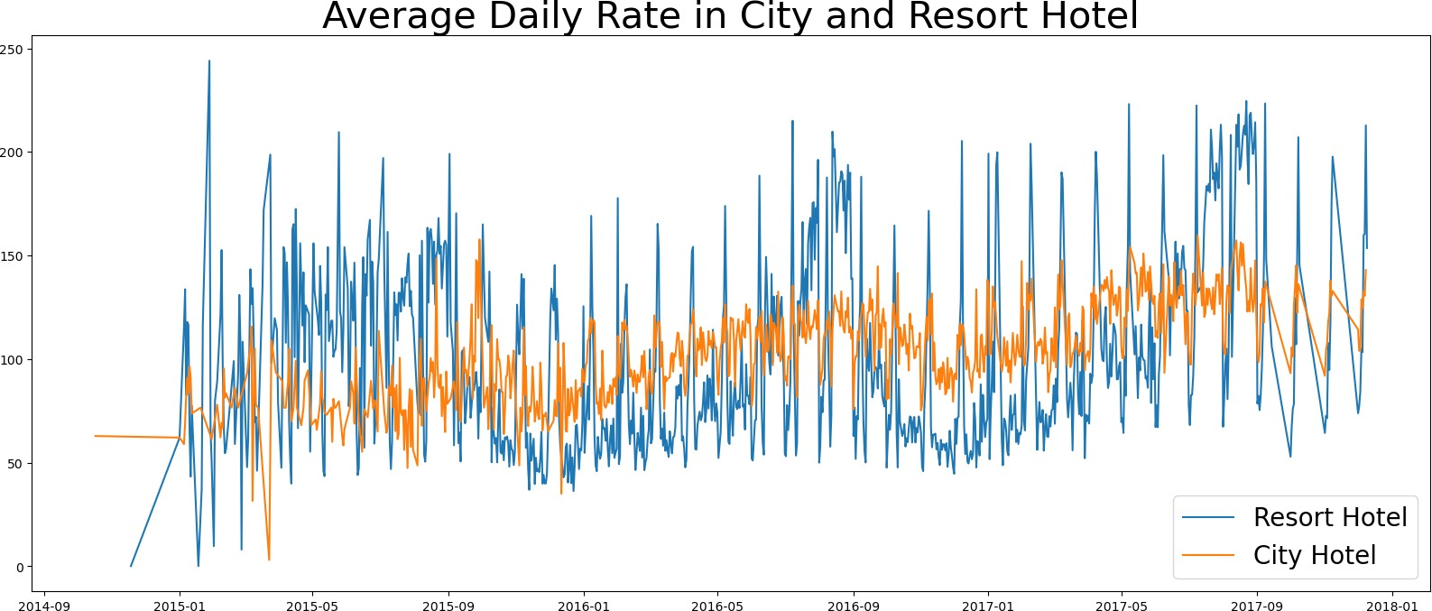
In comparison to resort hotels, city hotels have more bookings. It's possible that resort hotels are more expensive than those in cities.

Slide 7
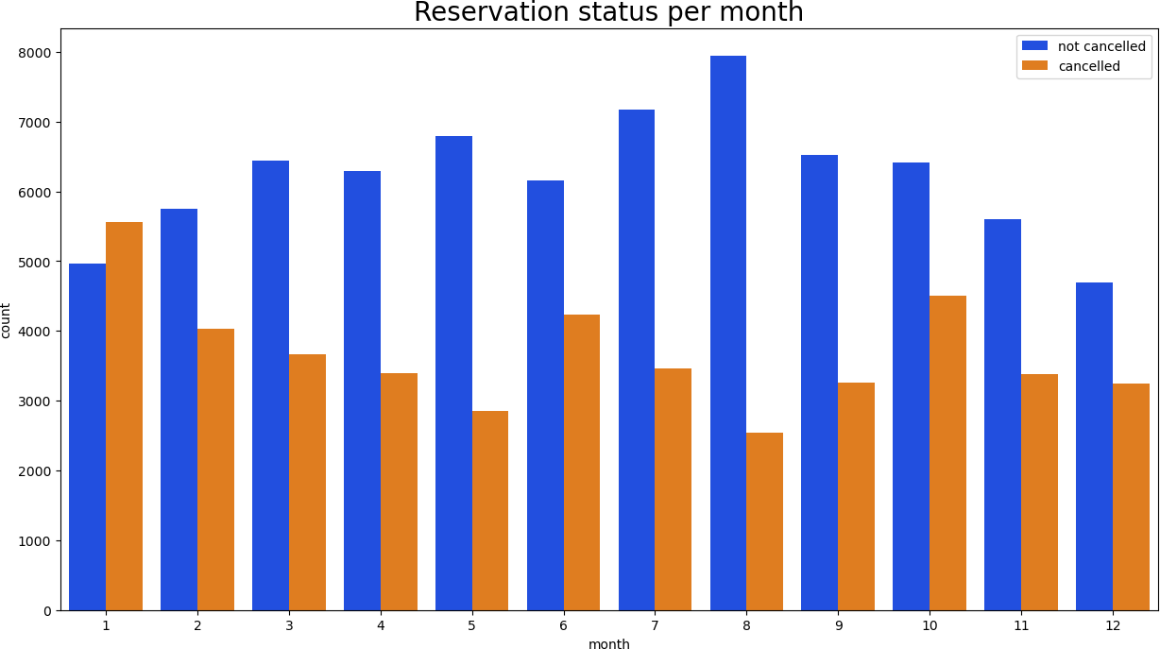
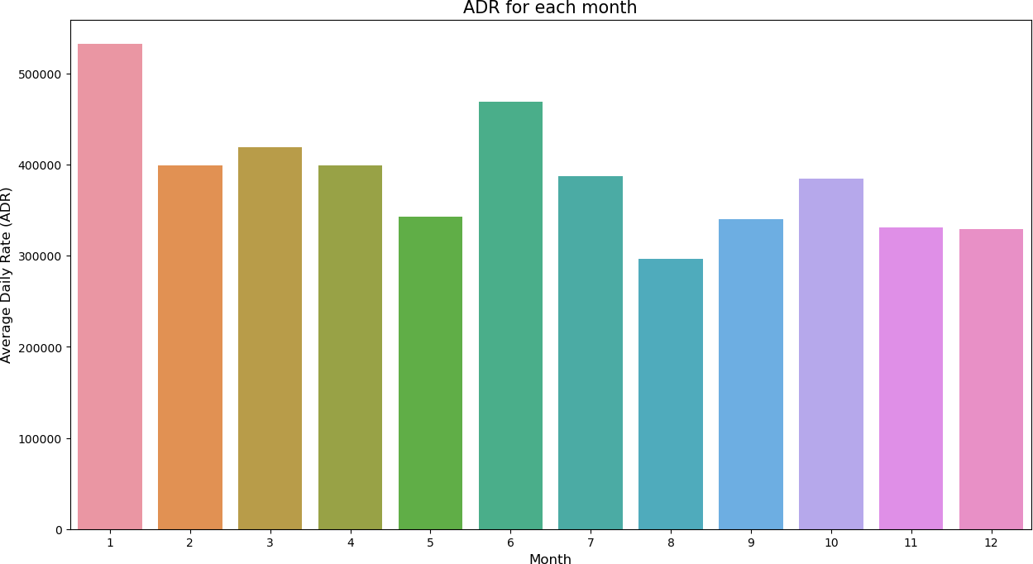
The line graph above shows that, on certain days, the average daily rate for a city hotel is less than that of a resort hotel, and on other days, it is even less. It goes without saying that weekends and holidays may see a rise in resort hotel rates.
We have developed the grouped bar graph to analyze the months with the highest and lowest reservation levels according to reservation status. As can be seen, both the number of confirmed reservations and the number of canceled reservations are largest in the month of August. whereas January is the month with the most canceled reservations.

Slide 8
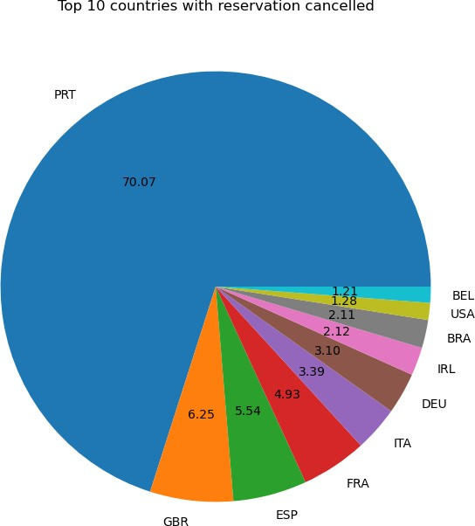
This bar graph demonstrates that cancellations are most common when prices are greatest and are least common when they are lowest. Therefore, the cost of the accommodation is solely responsible for the cancellation.
Now, let's see which country has the highest reservation canceled. The top country is Portugal with the highest number of cancellations.

Slide 9
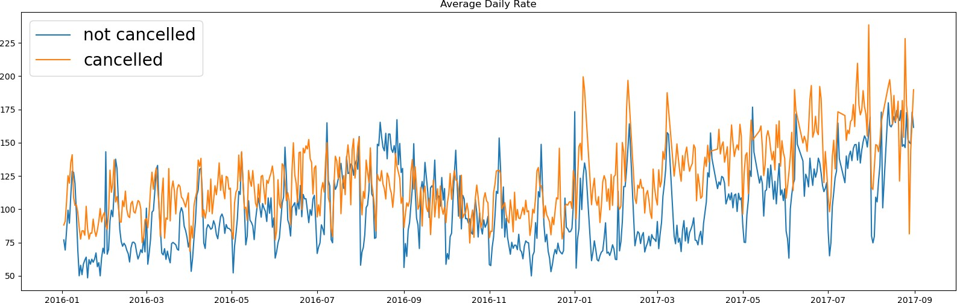
Let’s check the area from where guests are visiting the hotels and making reservations. Is it coming from Direct or Groups, Online or Offline Travel Agents? Around 46% of the clients come from online travel agencies, whereas 27% come from groups. Only 4% of clients book hotels directly by visiting them and making reservations.
As seen in the graph, reservations are canceled when the average daily rate is higher than when it is not canceled. It clearly proves all the above analysis, that the higher price leads to higher cancellation.

Slide 10
Suggestions
• Implement dynamic pricing strategies to mitigate cancellations caused by high prices.
• Offer weekend and holiday discounts specifically for resort hotels to boost occupancy rates.
• Launch targeted marketing campaigns in January to counteract the peak in cancellation rates during this month.
• Improve hotel quality and services in Portugal to reduce cancellation rates originating from this country.

